Slide 1





SK Bandhu

Slide 2
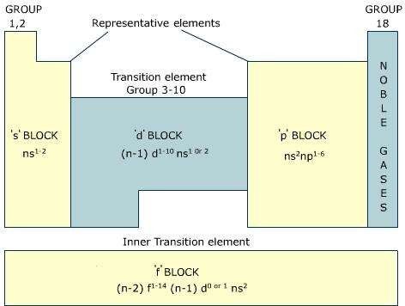

Slide 3
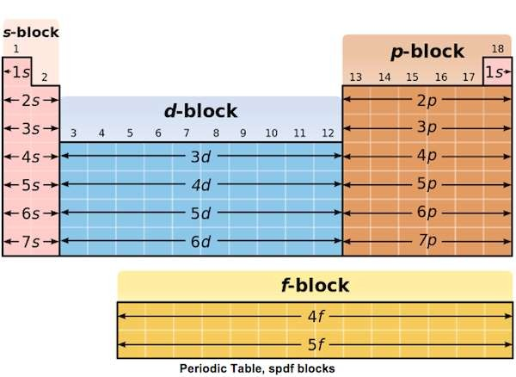

Slide 4


The p-block elements are placed in groups
13 – 18 .
The general electronic configuration is ns ² np^{1 – 6}.
The groups included in the syllabus are 15, 16, 17 and 18.

Slide 5
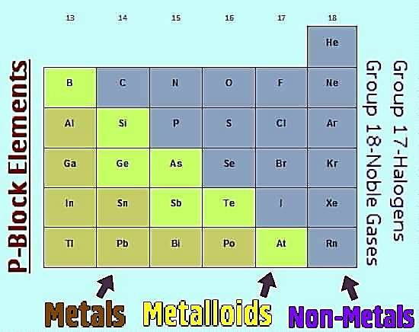

Slide 6

Nitrogen family: configuration is ns²np^{3.}
The elements of group 15 –
nitrogen (N),
phosphorus (P),
arsenic (As),
antimony (Sb)
bismuth (Bi)
In N-N2,HNO3,NH3 AND OXYACIDS OF N
In P-PCl3,PCl5,PH3 AND OXYACIDS OF P

Slide 7
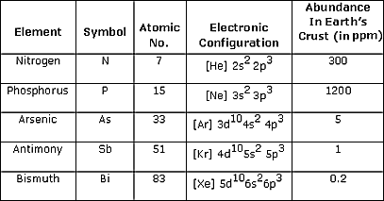

Slide 8
Periodic properties | Trends
Electronegativity:(the atom's ability of attracting electrons) | Decreases down the group
Ionization Enthalpy (the amount of energy required to remove an electron from the atom in it's gaseous phase) | decreases
Atomic Radii (the radius of the atom) | increases
Electron Affinity (ability of the atom to accept an electron) | decreases
Melting Point (amount of energy required to break bonds to change a solid phase substance to a liquid phase) | increases going down the group
Boiling Point (amount of energy required to break bonds to change a liquid phase substance to a gas) | increases going down the group

Slide 9








Element | Name of allotrope | Structure
Nitrogen | α – nitrogen cubic crystal β - nitrogen hexagonal crystalline
Phosphor ous | White Red black
Arsenic | Yellow Black Gray metallic | black
Antimon y | Yellow Form Metallic explosive
Bismuth | No allotropes

Slide 10
Action of air;(high temp arc)
N₂ + O₂ 2NO
Action oxidizing agents:
P₄ +20HNO₃ 4H₃PO₄ + 20 NO₂+4 H₂0 As₄ + 20 HNO₃ 4H₃AsO₄ + 20 NO₂+4 H₂0 4 Sb +20HNO₃ Sb₄O₁₀ + 20 NO₂+10 H₂0
Bi + 6HNO₃ Bi( NO₃)₃ + 3 NO₂+3 H₂0

Slide 11
Action of hot conc H₂SO₄
P₄ +10 H₂SO₄
4H₃PO₄ +
10 SO₂+4 H₂0
As₄ +10 H₂SO₄
4H₃AsO₄ +
4 Sb + 6 H₂SO₄
Sb₂(SO₄)₃ +
3 SO₂+6 H₂0
2Bi + 6 H₂SO₄
Bi ₂( SO₄)₃ +
Action of alkali
P₄ +3 NaOH + 3H₂0
PH₃ +3NaH₂PO₂
Action of metals 3Mg + N₂
Mg + P₄
Mg₃ N₂ Mg₃ P₂

Slide 12

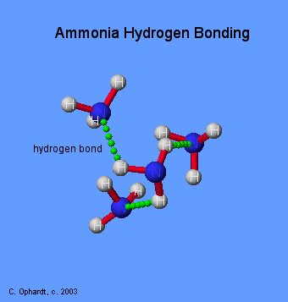
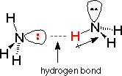
All form hydrides with
formula EH₃
( E = N, P, As, Sb , Bi) oxidation state = – 3
Hydrogen bonding in NH₃
The stability of hydrides decrease down the group due to decrease in bond dissociation energy down the group.
NH₃ > PH₃ > AsH₃ > SbH₃
> BiH₃

Slide 13
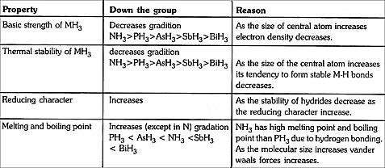

Slide 14







N is gas all are solids
N diatomic others tetra atomic
Forms H bonds in hydrides
forms p∏ - p∏ multiple bonds
Range of oxidation states -3 to +5
No d orbitals does not form co – ordination compounds

Slide 15



Commercial mtd :
BP 77.2 fractional distillation of air
Lab mtd:
NH₄Cl +NaNO₂ N₂ + 2 H₂O + NaCl
from azide :
2NaN₃ 2Na + 3N₂

Slide 16
2 isotopes ¹⁴N , ¹⁵N
3Mg + N₂
Mg₃ N₂
3H₂ + N₂
773K /200atm
2NH₃
O₂ + N₂
electric arc/ 2000K
2NO
CaCN₂ + C
CaC₂ + N₂
calcium cynamide

Slide 17

Lab method:
Ammonia is prepared by heating a mixture of calcium hydroxide and ammonium chloride.
2NH₄Cl + Ca( OH)₂ CaCl₂ + 2NH₃ +2 H₂O
Ammonia is collected by upward delivery as it is lighter than air and dried over quick lime CaO.

Slide 18

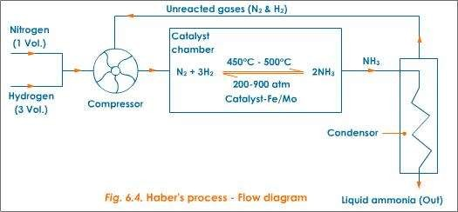

Slide 19


It is manufactured by reacting Nitrogen and hydrogen in the presence of finely divided catalyst at temperatures 700ºC at a pressure of about 200 atmospheres.
^{N}2(g) ^{+ 3H}2(g) ^{2NH}3(g)
Alminium Oxide ferric oxide and potassium oxide is added to the catalyst to improve its performance.
It makes it more porous and this provides a high surface area to
the reaction.
The reaction is reversible hence it is not possible to convert all the reactants into ammonia.
To separate ammonia from the mixture is cooled, only ammonia liquidfies and it is separated.
The uncombined Nitrogen and hydrogen are recycled. Another way of separation is to pass the mixture into water. Only ammonia dissolves.

Slide 20
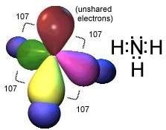
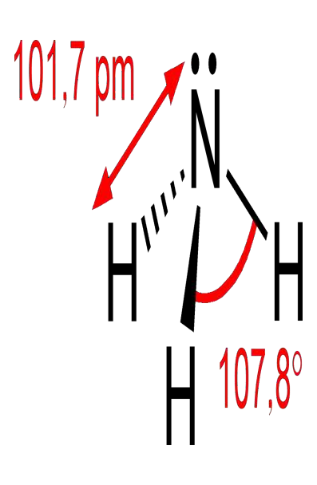

Slide 21


1] with air: Ammonia burns in a lot of air (oxygen). The flame is yellow green
4NH₃(g) + 3O₂(g) → 6H₂O(g) + 2N₂(g)
react with oxygen in excess air, and platinum catalyst to
form nitrogen monoxide
4NH₃(g) + 5O₂(g) → 4NO(g) + 6H₂O(l)
2] reduces : Ammonia reduces heated copper(II) oxide to copper i.e. copper turns from black to brown.
3CuO(s) + 2NH₃(g) → 3Cu(s) + 3H₂O(l) + N₂(g)

Slide 22
3] halogens
3Cl₂(g) + 8NH₃(g) → 6NH₄Cl(s) + N₂(g).
In excess
NH₃(g) + 3Cl₂(g) →NCl₃(l) + 3HCl(g)
4] co – ordination complex Ammonia solution (Ammonium hydroxide) contains hydroxyl ions with metal ions precipitates of the hydroxides are formed. Hence a blue precipitate forms when aqueous ammonia is added to copper II sulphate solution. The precipitate dissolves in excess ammonia forming a deep blue solution.
Cu_{(aq)}²⁺ + 2OH⁻_{(aq)} Cu(OH)_{2(s)}
Cu²⁺(aq) + 4NH₃(aq) → Cu(NH₃)₄ (aq)
2+
Iron(II) is (Fe²⁺) forms a dirty green precipitate with ammonia insoluble in excess Iron(III) is (Fe³⁺) forms a brown precipitate insoluble in excess.
5] with active metals
2Na + 2NH₃ NaNH₂ + H₂

Slide 23

Its aqueous solution is weakly basic due to the
formation of OH⁻ ions,
NH₃ + H₂O ———→ NH⁺₄ + OH⁻
With sodium hypochlorite in presence of glue or
gelatine, excess of ammonia gives hydrazine
2NH₃ + NaOCI ——→ NH₂.NH₂ + NaCI + H₂O
With Nessler’s reagent (an alkaline solution of K₂HgI₄ Pottassium tetraiodate mercury) , ammonia and ammonium salts give a brown precipitate due to the formation of Millon’s base.
2K₂HgI₄ + NH₃ + 3KOH ——→ H₂N - Hg - O Hg - I 7KI +
2H₂O

Slide 24

Uses of ammonia
It is used in the manufacture of fertilizers
e.g. Ammonium sulphate.
It is used in softening water.
It is used in making nitric acid.
It is used in making plastics.

Slide 25

Lab method
NaNO₃ + H₂SO₄ → 2 HNO₃ + NaHSO₄
Large scale
4 NH₃ (g) + 5 O₂ (g) → 4 NO (g) + 6 H₂O (g)
Nitric oxide is then reacted with oxygen in air to form nitrogen dioxide.
2 NO (g) + O₂ (g) → 2 NO₂ (g) (ΔH = −114 kJ/mol)
This is subsequently absorbed in water to form nitric acid and nitric oxide.
3 NO₂ (g) + H₂O (l) → 2 HNO₃ (aq) + NO (g)

Slide 26

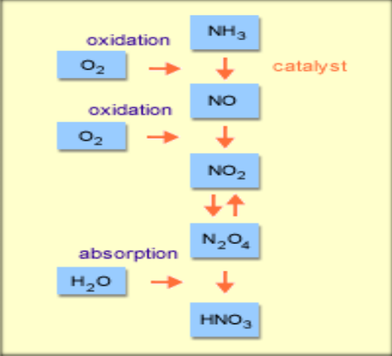

Slide 27
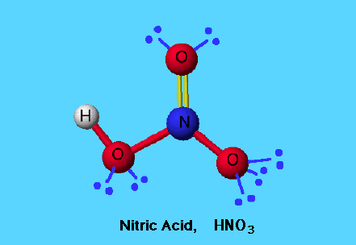
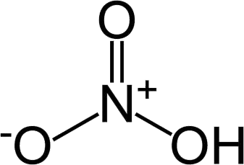

Slide 28

1] dilute
3 Cu + 8 HNO₃ → 3 Cu (NO₃)₂ + 2 NO + 4 H₂O
2] concentrated
Cu + 4 HNO₃ → Cu (NO₃)₂ + 2 NO₂ + 2 H₂O
3]non – metals
C + 4HNO₃ → CO₂ + H₂O +4NO₂
4] metals
Au + HNO₃ + 3HCl → HAuCl₄ + NOCl+ 2 H₂O
aqua - regia aurochloric acid

Slide 29
C₆H₆ + 2HNO₃
1. with benzene
conc H₂SO₄
C₆H₅ NO₂+ 2H₂O
2. With toluene
C₆H₅ CH₃ +3 HNO₃
conc H₂SO₄
C₆H₂ (NO₂)₃ CH₃ + 3H₂O
2,4,6, trinitro toluene
With phenol
C₆H₅ OH + 3HNO₃ C₆H₂ (NO₂)₃ OH + 3H₂O
With cane sugar forms oxalic acid and water
C₁₂H₂₂O₁₁ +18 (O) 6(COOH)2 + 5H₂O

Slide 30

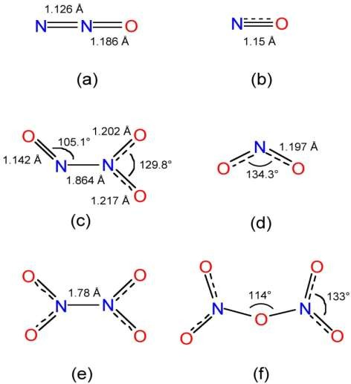
Dinitrogen monoxide N₂O
Nitrogen monoxide
NO
Dinitrogen trioxide N₂O₃
Nitrogen dioxide =
NO₂
Dinitrogen tetroxide N₂O₄
Dinitrogen pentoxide
N₂O₅

Slide 31
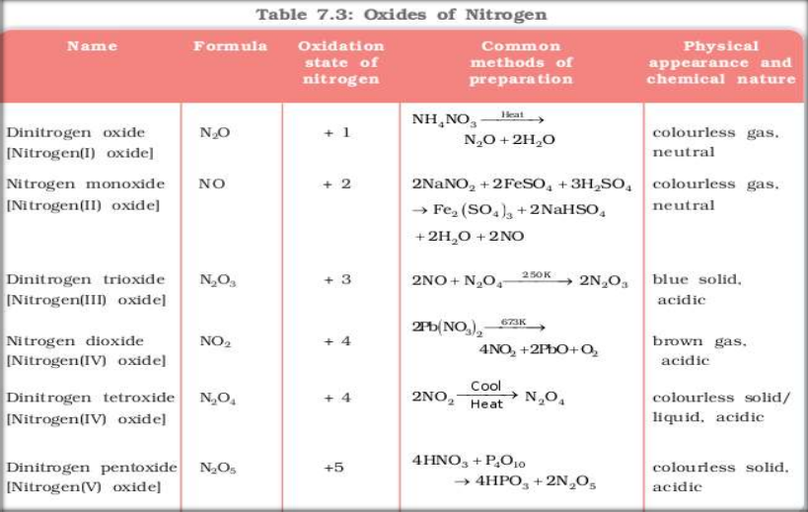

Slide 32
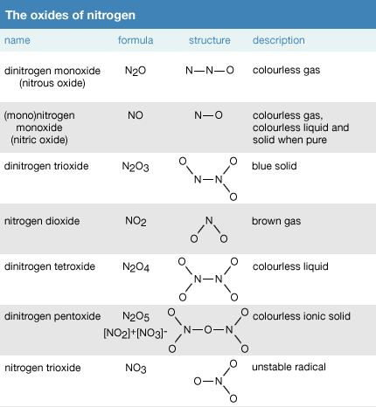

Slide 33
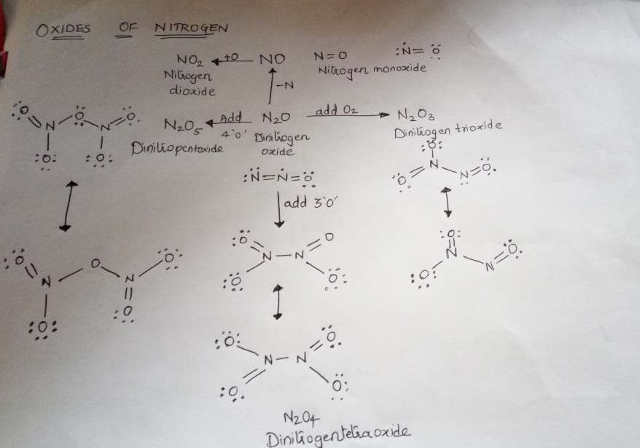

Slide 34

Exist in three allotropic forms- white, red and black.
White phosphorous burns in air with faint green glow, phenomenon is called chemiluminescence.
  P₄ + 5O₂--> P₄O₁₀

Slide 35
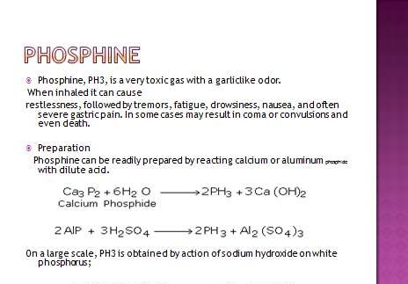

Slide 36


Reaction with chlorine PH₃ +4CL₂
PCl₅ + 3HCl
Reaction with CuSO4
CuSO₄ + PH₃ Cu₃P₂ + 3H₂SO₄
Reaction with mercuric chloride
HgCl₂ + PH₃ Hg₃P₂ +6HCl
Reaction to form phosphonium salts
HBr + PH₃ PH₄ Br

Slide 37



Dry chlorine when passed over heated white phosphorous, gives phophorous trichloride.
P₄ + 6Cl₂ 4PCl₃
It is also obtained by the action of thionyl chloride (SOCl₃) with white phosphorous.
P₄ + 8SOCl₂ 4PCl₃ + 2S₂Cl₂ + 4SO₂

Slide 38


PCl₃ + 3H₂O
PCl₃ + Cl₂ 3CH₃COOH + PCl₃
3C₂H₅OH + PCl₃
3AgCN + PCl₃
H₃PO₃ + 3HCl
PCl₅
3CH₃COCl + H₃PO₄
3C₂H₅Cl + H₃PO₄ P(CN)₃ + AgCl

Slide 39

Prepared by passing excess of chlorine gas over white phosphorous:
P₄ + 10 Cl₂ 4PCl₅
Prepared by action of SO₂Cl₂ on phosphorous: P₄ + 10 SO₂Cl₂ 4PCl₅ + 10 SO₂

Slide 40

PCl₅ + H₂O
POCl₃ + 3H₂O PCl₅
C₂H₅OH + PCl₅
POCl₃ + 2HCl
H₃PO₄ + 3HCl PCl₃ + Cl₂
C₂H₅Cl + POCl₃ + HCl
CH₃COOH + PCl₅
2Ag + PCl₅ Sn + 2PCl₅
CH₃COCl + POCl₃ + HCl
2AgCl + PCl₃ SnCl₄ + 2PCl₃

Slide 41
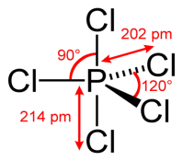
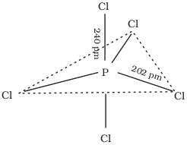
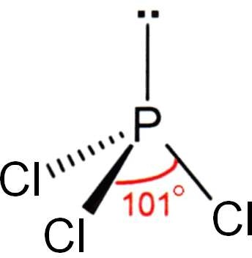

Slide 42

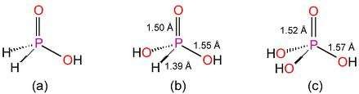
a.Hypophorphorous H₃PO₂ b.Orthophosphorous H₃PO₃
c. Orthophosphoric H₃PO₄

Slide 43

pyrophosphorous acid H₄P₂O₅ Pyrophosphoric acid H₄P₂0₇

Slide 44
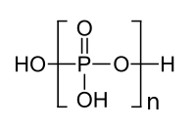
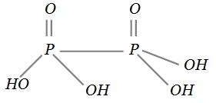
Hypophosphoric H₄P₂O₆
Poly meta phosphoric acid
[HPO3]n

Slide 45
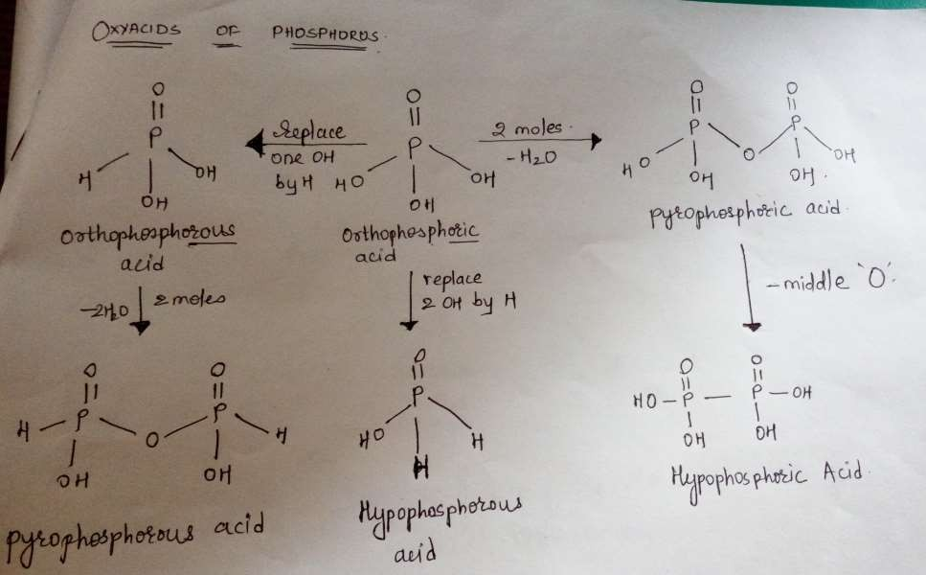

Slide 46
. Oxygen family: Group 16 of periodic table consists of five elements –
oxygen (O), sulphur (S),
selenium (Se), tellurium (Te) and polonium (Po).
Their general electronic configuration is ns²np⁴.

Slide 47
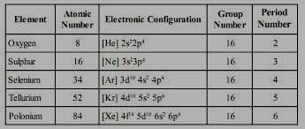

Slide 48

Periodic properties | Trends
Atomic Radii (the radius of the atom) | increases
Electronegativity:(the atom's ability of attracting electrons) | Decreases down the group
Ionization Enthalpy (the amount of energy required to remove an electron from the atom in it's gaseous phase) | decreases
Electron Affinity (ability of the atom to accept an electron) | decreases
Melting Point (amount of energy required to break bonds to change a solid phase substance to a liquid phase) | increases going down the group
Boiling Point (amount of energy required to break bonds to change a liquid phase substance to a gas) | increases going down the group

Slide 49
Their general electronic configuration is ns²np⁴
The most common oxidation state is – 2.
The most common oxidation state for the chalcogens are −2, +2, +4, and +6.

Slide 50
Reaction with air:
·
S + O₂ SO₂
with acid[ only oxidizing acids]
S + 6HNO₃
With alkali
3S +6 NaOH
H₂SO₄
+6NO₂ +2H₂O
Na₂SO₃ +2 Na₂S + 3H₂O

Slide 51

with non - metals
2S + C
S + H₂
S + 3F₂
CS₂
·
·
H₂S
SF₆
with metals
Cu + S
CuS

Slide 52

1. The metallic character increases as we descend the group. Oxygen and sulphur are typical nonmetals. Selenium (Se) and Te are metalloids and are semiconductors. Polonium is a metal.
2. Tendency to form multiple bond decreases down the group.
Example O=C=O is stable, S=C=C is moderately stable, Se=C=Se decomposes readily and Te=C=Te is not formed.

Slide 53
All the elements of group 16 form hydrides of the type H₂M (where M= O, S, Se, Te or Po).
The stability of hydrides decreases as we go down the group.
Except H₂O, all other hydrides are poisonous foul
smelling gases.
Their acidic character and reducing nature increases down the group. [ less energy to break M – H bond ]
All these hydrides have angular structure and the
central atom is in sp³ hybridised.
H – M – H Bond angle decreases.
BP also decreases from H₂O TO H₂S then increases.

Slide 54
Element of group 16 form a large number of halides. The compounds of oxygen with fluorine are called oxyfluorides because fluorine is more electronegative than oxygen (example OF₂).
The main types of halides are
Monohalides of the type M₂X₂
Dihalides of the type MX₂
Tetrahalides of the type MX₄
Hexahalides of the type MX₆

Slide 55
Group 16 elements mainly form three types of oxides.
Monoxides: Except Selenium (Se), all other elements of the group form monoxides of the type MO (Example SO)
Dioxides: All the elements of group 16 form dioxides of the type MO₂ (Example SO₂)
Trioxides: All the elements of the group form trioxides of the type MO₃

Slide 56


O is gas all are solids.
O diatomic others poly atomic.
O₂is paramagnetic others diamagnetic.
Forms H bonds in hydrides, alcohols and carboxylic acids.
forms p∏ - p∏ multiple bonds.
oxidation states -2 and +2 only with F others
+2 and +6.
Forms ionic compounds.

Slide 57

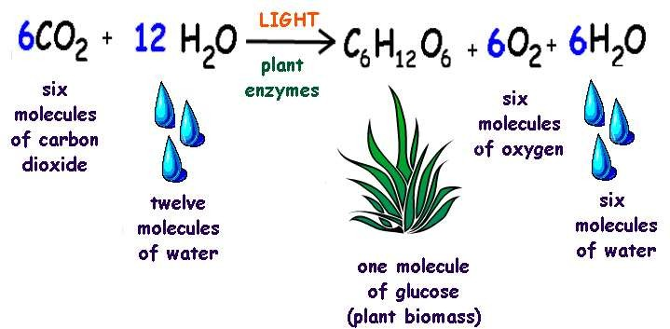

Slide 58
thermal decomposition of oxygen rich compounds
Potassium chlorate will readily decompose if heated in contact with a catalyst, typically manganese (IV) dioxide (MnO₂) .
2 KClO₃(s) → 3 O₂(g) + 2KCl(s)
2 KNO₃ → 2 KNO₂ + O₂
2 KMnO₄ ==> K₂MnO₄ + MnO₂ + O₂

Slide 59

Preparation of oxygen using hydrogen peroxide
The decomposition of hydrogen peroxide using manganese dioxide as a catalyst also results in the production of oxygen gas.
2 H₂O₂ ==> 2 H₂O + O₂
2 BaO₂ ==> 2 BaO + O₂
6 MnO₂ ==> Mn₃O₄ + O₂
2 Pb₃O₄ ==> 6 PbO + O₂
2 PbO₂ ==> 2 PbO + O₂

Slide 60

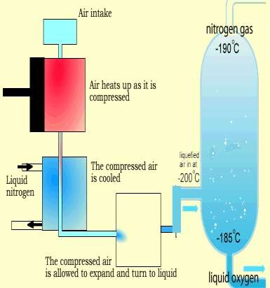
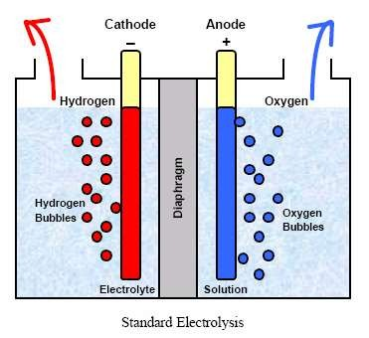
1.electrolysis of acidified water
2.Fractional distillation of liquid air

Slide 61
Oxygen is a colourless gas, without smell or taste,
is slightly heavier than air,
is sparingly soluble in water,
is difficult to liquefy, boiling point 90.2K, and the liquid is pale blue in colour and is appreciably magnetic.
At still lower temperatures, light-blue solid oxygen is obtained, which has a melting point of 54.4K.

Slide 62

With metals
Potassium, sodium, lithium, calcium and magnesium
react with oxygen and burn in air.
4Na_{(s)} + 2Na₂O_{(s)}
^{O}2(g)
2Ca_{(s)} 2CaO_{(s)}
^{+ O}2(g)
Metals in the reactivity series from aluminium to copper
react with oxygen in the air to form the metal oxide
4Fe_{(s)}
^{+ 3O}2(g) ^{2Fe}2^{O}3(s)

Slide 63


When carbon reacts with excess of oxygen, carbon dioxide is formed along with production of heat.
When carbon is burnt in limited supply of air, it forms carbon monoxide. Carbon monoxide is a toxic substance. Inhaling of carbon monoxide may prove fatal.

Slide 64


Sulphur gives sulphur dioxide on reaction with oxygen. Sulphur catches fire when exposed to air.
(3) When hydrogen reacts with oxygen it gives water.

Slide 65

With ammonia :react with oxygen in excess air, and platinum catalyst to form nitrogen monoxide
4NH₃(g) + 5O₂(g) → 4NO(g) + 6H₂O(l)
Sulphur dioxide gives sulphur trioxide when reacts with oxygen.

Slide 66
Reacts with metal sulphides forming metal oxides and sulphur dioxide.
Reacts with hydrocarbons forming carbon dioxide and water.

Slide 67

Oxygen is essential for life and it takes part in processes of combustion, its biological functions in respiration make it important. Oxygen is sparingly soluble in water, but the small quantity of dissolved oxygen in is essential to the life of fish.
Oxygen gas is used with hydrogen or coal gas in blowpipes and with acetylene in the oxy-acetylene torch for welding and cutting metals.
Oxygen gas is also used in a number of industrial processes.
Medicinally, oxygen gas is used in the treatment of pneumonia and gas poisoning, and it is used as an anesthetic when mixed with nitrous oxide, ether vapour, etc..
Carbon Dioxide is often mixed with the oxygen as this stimulates breathing, and this mixture is also used in cases of poisoning and collapse for restoring respiration.
Liquid oxygen mixed with powdered charcoal has been used as an explosive.

Slide 68

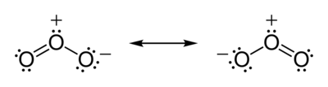
Ozone ( O₃), or trioxygen, is a triatomic molecule,
consisting of three oxygen atom.
It is an allotrope of oxygen that is much less stable than the diatomic allotrope (O₂), breaking down in the lower atmosphere to normal dioxygen.
Ozone is formed from dioxygen by the action
of ultraviolet light and also atmospheric electrical discharges, and is present in low concentrations throughout the Earth's atmosphere.
In total, ozone makes up only 0.6 parts per million of the
atmosphere.

Slide 69
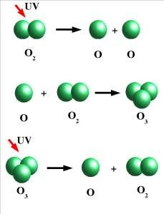
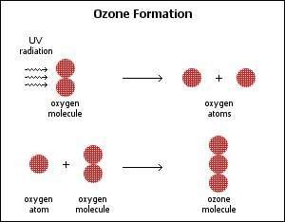

Slide 70
Ozone is a pale blue gas, slightly soluble in water and much more soluble in inert non- polar solvents such as carbon tetrachloride or fluorocarbons,
where it forms a blue solution. At 161
K (−112 °C; −170 °F), it condenses to form a dark blue liquid.
At temperatures below 80 K (−193.2 °C;
−315.7 °F), it forms a violet-black solid.

Slide 71
Ozone is a powerful oxidizing agent, far stronger
than O₂.
It is also unstable at high concentrations, decaying to ordinary diatomic oxygen (with a half-life of about half an hour in atmospheric conditions):
2 O₃ → 3 O₂
Ozone also oxidizes nitric oxide to nitrogen dioxide:
NO + O₃ → NO₂ + O₂
Ozone oxidizes sulfides to sulfates . For example, lead(II) sulfide is oxidised to lead(II) sulfate:
PbS + 4 O₃ → PbSO₄ + 4 O₂

Slide 72

Reducing action with BaO₂ and H₂O₂
BaO₂ + O₃ → BaO + 2O₂
H₂O₂ + O₃ H₂O + 2O₂
Reacts with KI to liberate iodine
2KI + O₃ + H₂O 2 KOH + I₂
+ O₂

Slide 73
Ozone is a reagent in many organic reactions in the
laboratory and in industry.
Ozonolysis is the cleavage of
an alkene to carbonyl compounds.
Many hospitals around the world use large ozone generators to decontaminate operating rooms between surgeries. The rooms are cleaned and then sealed airtight before being filled with ozone which effectively kills or neutralizes all remaining bacteria.^{[62]}
Ozone is used as an alternative to chlorine or chlorine dioxide in the bleaching of wood pulp.
It is often used in conjunction with oxygen and hydrogen peroxide to eliminate the need for chlorine-containing compounds in the manufacture of high-quality,
white paper.
Ozone can be used to detoxify cyanide wastes

Slide 74

sulphides : pyrites : Cu₂S , FeS
Blende ZnS , cinnabar HgS and
galena PbS
Sulphates : gypsum CaSO₄ .2H₂O
epsum MgSO₄ .7H₂O burytes BaSO₄
glaubers salt Na₂SO₄ .10H₂O
H2S in volcanic gases . In proteins

Slide 75

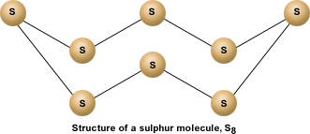
Rhombic sulphur :This allotrope is yellow in colour, m.p.
385.8 K and specific gravity 2.06. Rhombic sulphur crystals are formed on evaporating the solution of roll sulphur in CS₂. It is insoluble in water but dissolves to some extent in benzene, alcohol and ether. It is readily soluble in CS₂.It is also called octahedral sulphur

Slide 76
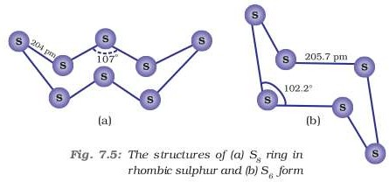
Monoclinic sulphur (β-sulphur) cyclo 6
Its m.p. is 393 K and specific gravity 1.98. It is soluble in CS₂

Slide 77
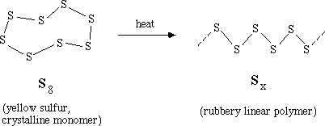
Plastic or γ - sulphur

Slide 78
Milk of sulphur
Prepared by boiling of sulphur with milk of lime, a mixture of Ca penta sulphide and thiosulphate are formed which on treatment with HCl give milk of sulphur
Colloidal sulphur
Thiosulfate react with dilute acids to produce sulfur, sulfur dioxide and water.
Na₂S₂O₃ + 2 HCl → 2 NaCl
+ S + SO₂ + H₂O
Action of H₂S on SO₂
2H₂S on SO₂ 3 S +
2H₂O
3Ca (OH)₂ + 12S + 6HCl
3CaCl₂ + 12S +2H₂O

Slide 79



Preparation : Sulphur dioxide is formed together with a little (6-8%) sulphur trioxide when sulphur is burnt in air or oxygen:
S(s) + O₂(g) → SO₂ (g)
Industrially, it is produced as a by-product of the roasting of sulphide ores.
4FeS₂ (s ) + 11O₂ ( g ) → 2Fe₂O3 ( s ) + 8SO₂ ( g )
Laboratory method Action of sulphuric acid on Cu turnings
Cu + 2 H₂SO₄ → CuSO₄ + SO₂ + 2 H₂O

Slide 80
Sulphur dioxide is a colourless gas with pungent smell
is highly soluble in water.
It liquefies at room temperature under a pressure of two atmospheres
and boils at 263 K.

Slide 81
Treatment of basic solutions with sulphur dioxide
forms sodium sulphate
SO₂ + 2 NaOH → Na₂SO₃ + H₂O
It is oxidized by halogens to give the sulfuryl halides,
such as sulfuryl chloride :
SO₂ + Cl₂ → SO₂Cl₂
Sulfur dioxide is the oxidising agent . sulfur dioxide is reduced by hydrogen sulfide to give elemental sulfur:
SO₂ + 2 H₂S → 3 S + 2 H₂O
The sequential oxidation of sulfur dioxide followed by its hydration is used in the production of sulfuric acid.
2 SO₂ + 2 H₂O + O₂ → 2 H₂SO₄

Slide 82
With iodine
I₂ + SO₂ + 2 H₂O → 2 HI+ H₂SO₄
With dichromate
Potassium dichromate paper can be used to test for sulfur dioxide, as it turns distinctively from orange to green
Cr₂(SO₄)_{3(aq)} +
^{K}2^{SO}4(aq) ^{+ H}2^{O}(l)
^{K}2^{Cr}2^{O}7(aq) ^{+ 3SO}2(g) ^{+H}2^{SO}4(aq)

Slide 83

When moist, sulphur dioxide behaves as a reducing agent. For example,
it converts iron(III) ions to iron(II) ions 2Fe³⁺ + SO₂ + 2H₂O → 2Fe²⁺ + SO² ⁻₄ + 4H⁺
and decolourises acidified potassium permanganate(VII) solution;
this reaction is a convenient test for the gas.
5SO₂+ 2MnO₄ + 2H₂O → 5SO₄²⁻ + 4H⁺ + 2Mn²⁺

Slide 84





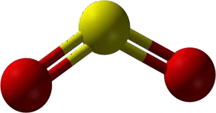
Sp2 hybridization in sulphur

Slide 85
Sulphur dioxide is a reducing agent and is used for bleaching and as a fumigant and food preservative.
Large quantities of sulphur dioxide are used in the contact process for the manufacture of sulphuric acid.
Sulphur dioxide is used in bleaching wool or straw, and as a disinfectant.
Liquid sulphur dioxide has been used in purifying petroleum products

Slide 86




The process can be divided into five stages:
combining of sulfur and oxygen;
purifying sulfur dioxide in the purification unit;
adding excess of oxygen to sulfur dioxide in presence of catalyst vanadium oxide;to form sulphur trioxide
sulfur trioxide formed is added to sulfuric acid which gives rise to oleum (disulfuric acid);
the oleum then is added to water to form sulfuric acid which is very concentrated

Slide 87
Sulphur or iron pyrites burnt in air
S(s) + O₂(g) → SO₂ (g)
Sulfur dioxide and oxygen then react as follows: 2 SO₂(g) + O₂(g) ⇌ 2 SO₃(g)
Hot sulfur trioxide passes through the heat exchanger and is dissolved in concentrated H₂SO₄ in the absorption tower to form oleum:
H₂SO₄(l) + SO₃(g) → H₂S₂O₇(l)
Oleum is reacted with water to form concentrated H₂SO₄.
H₂S₂O₇(l) + H₂O(l) → 2 H₂SO₄(l)

Slide 88
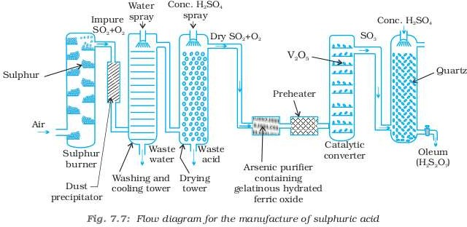

Slide 89
Mixture of SO₂ , NO and air is treated to steam to obtain sulphuric acid. NO ,nitric oxide acts as a catalyst.
NO
2SO₂ + O₂(g) + 2H₂O → 2H₂SO₄

Slide 90


Sulphuric acid is a colourless, dense, oily liquid with a specific gravity of 1.84 at 298 K.
The acid freezes at 283 K and boils at 611 K.
It is highly soluble in water with the evolution of a large quantity of heat. Hence, care must be taken
. It has more affinity to water

Slide 91



In aqueous solution, sulphuric acid ionises in two steps.
H₂SO₄(aq) + H₂O(l) → H₃O⁺ (aq) + HSO₄⁻ (aq);
K_{a1} = very large ( K_{a1}>10)
HSO₄ (aq) + H₂O(l) → H₃O⁺ (aq) + SO₄²⁻ (aq) ;
K_{a2}> = 1.2 × 10⁻²
The larger value of ka indicates stronger is the acid

Slide 92


Action on cane sugar
Action on formic acid HCOOH CO +H₂O
Action on alcohol C₂H₅OH
C₂H₅OC₂H₅
+ H₂O

Slide 93


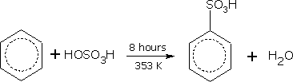
Cu + 2 H₂SO₄(conc.) → CuSO₄ + SO₂ + 2H₂O
3S + 2H₂SO₄(conc.) → 3SO₂ + 2H₂O
C + 2H₂SO₄(conc.) → CO₂ + 2 SO₂ + 2 H₂O
dilute acid reacts with metals liberating H₂ gas. Reaction with benzene
benzene sulphonic acid

Slide 94
Sulphuric acid is a very important industrial
chemical. uses are in:
(a) petroleum refining
(b) manufacture of pigments, paints and dyestuff intermediates
(c) detergent industry
(d) metallurgical applications (e.g., cleansing metals before enameling, electroplating and galvanising
(e) storage batteries
(f) in the manufacture of nitrocellulose products and
(g) as a laboratory reagent.

Slide 95


Sulphoxylic acid H₂SO₂
Sulphurous acid H₂S₂O_{2 ,}H₂SO₃ H₂S₂O₄, H₂S₂O₅
sulphuric acid H₂SO₄, H₂S₂O_{3 ,}H₂S₂O₇
peroxy sulphuric acid H₂SO₅, H₂S₂O₈ .
Thionic acid series : dithionic acid H₂S₂O₆ poly thionic acid H₂SnO₆ (n = 3 to 6)
Some of these acids are unstable and cannot be isolated.

Slide 96
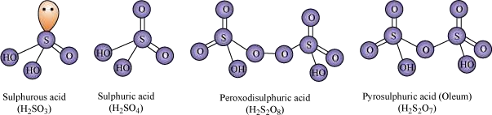

Slide 97
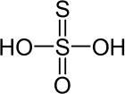
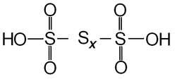
Thiosulphuric acid
Polythionic acid

Slide 98
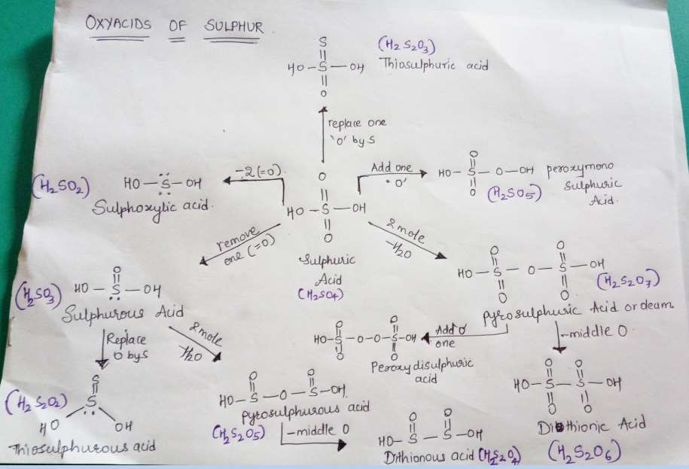

Slide 99
The halogen family: Group 17 elements, fluorine (F), chlorine (Cl), bromine (Br), iodine (I) and astatine (At), belong to halogen family. Their general electronic configuration is ns²np⁵.

Slide 100
Fluorine and chlorine are fairly abundant while bromine and iodine less so.
Fluorine is present mainly as insoluble fluorides (fluorspar CaF₂, cryolite Na₃AlF₆ and fluoroapatite 3Ca₃(PO₄)₂.CaF₂)
small quantities are present in soil, river water plants and bones and teeth of animals.
Sea water contains chlorides, bromides and iodides of sodium, potassium, magnesium and calcium, but is mainly sodium chloride solution

Slide 101
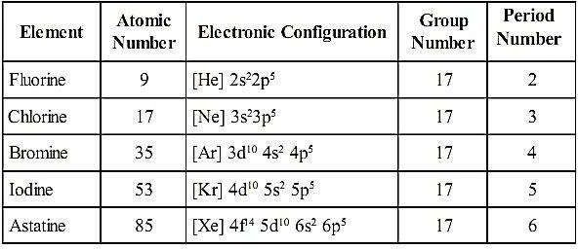

Slide 102





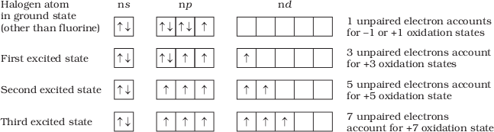
All the halogens exhibit –1 oxidation state. However, chlorine, bromine and iodine exhibit + 1, + 3, + 5 and + 7 oxidation states

Slide 103
The ready acceptance of an electron is the reason for the strong oxidising nature of halogens. F₂ is the strongest oxidising halogen and it oxidises other halide ions in solution or even in the solid phase. In general, a halogen oxidises halide ions of higher atomic number.
F₂ + 2X– → 2F– + X₂ (X = Cl, Br or I) Cl₂ + 2X– → 2Cl– + X₂ (X = Br or I) Br₂ + 2I– → 2Br– + I₂

Slide 104

Halogens react with metals to form metal halides. For example, bromine reacts with magnesium to give magnesium bromide. Mg ( s ) + Br₂ ( l ) → MgBr₂ ( s )
The ionic character of the halides decreases in the order MF > MCl > MBr > MI

Slide 105
Reactivity towards hydrogen: They all react with hydrogen to give hydrogen halides but affinity for hydrogen decreases from fluorine to iodine. Hydrogen halides dissolve in water to form hydrohalic acids
.

Slide 106
Halogens form many oxides with oxygen but most of them are unstable. Fluorine forms two oxides OF₂ and O₂F₂. However, only OF₂ is thermally stable at 298 K. These oxides are essentially oxygen fluorides because of the higher electronegativity of fluorine than oxygen. Both are strong fluorinating agents

Slide 107

Chlorine, bromine and iodine form oxides in which the oxidation states of these halogens range from +1 to +7. A combination of kinetic and thermodynamic factors lead to the generally decreasing order of stability of oxides formed by halogens, I > Cl > Br. The higher oxides of halogens tend to be more stable than the lower ones.
Chlorine oxides, Cl₂O, ClO₂, Cl₂O₆ and Cl₂O₇ are highly reactive oxidising agents and tend to explode. ClO₂ is used as a bleaching agent for paper pulp and textiles and in water treatment.

Slide 108
The bromine oxides, Br₂O, BrO₂ , BrO₃ are the least stable halogen oxides (middle row anomally) and exist only at low temperatures. They are very powerful oxidising agents.
The iodine oxides, I₂O₄ , I₂O₅, I₂O₇ are insoluble solids and decompose on heating. I₂O₅ is a very good oxidising agent and is used in the estimation of carbon monoxide.

Slide 109
Reactivity of halogens towards other halogens:
Halogens combine amongst themselves to form a number of compounds known as interhalogens of the types XX ′ , XX₃′, XX₅′
and XX₇′ where X is a larger size halogen and X’ is smaller size halogen.

Slide 110


ionisation enthalpy, electronegativity, and electrode potentials are all higher for fluorine than expected from the trends set by other halogens.
Also, ionic and covalent radii, m.p. and b.p., enthalpy of bond dissociation and electron gain enthalpy are quite lower than expected.
The anomalous behaviour of fluorine is due to its small size, highest electronegativity, low F-F bond dissociation enthalpy, and non availability of d orbitals in valence shell. Most of the reactions of fluorine are exothermic (due to the small and strong bond formed by it with other elements).
It forms only one oxoacid while other halogens form a
number of oxoacids.
Hydrogen fluoride is a liquid (b.p. 293 K) due to strong hydrogen bonding. Other hydrogen halides are gases.

Slide 111

Chlorine was discovered in 1774 by Scheele by the action of HCl on MnO₂.
In 1810 Davy established its elementary nature and suggested the name chlorine on account of its colour (Greek, chloros = greenish yellow

Slide 112

It can be prepared by any one of the following methods:
  By heating manganese dioxide with concentrated hydrochloric acid.
MnO₂ + 4HCl → MnCl₂ + Cl₂ + 2H₂O
  By the action of HCl on potassium permanganate.
2KMnO₄ + 16HCl → 2KCl + 2MnCl₂ + 8H₂O +
5Cl₂

Slide 113
(i) Deacon’s process: By oxidation of hydrogen chloride gas by atmospheric oxygen in the presence of CuCl₂ (catalyst) at 723 K.
(ii) Electrolytic process: Chlorine is obtained by the electrolysis of brine (concentrated NaCl solution). Chlorine is liberated at anode. It is also obtained as a by–product in many chemical industries.

Slide 114

It is a greenish yellow gas with pungent and suffocating odour. It is about 2-5 times heavier than air. It can be liquefied easily into greenish yellow liquid which boils at 239 K. It is soluble in water.
Chlorine reacts with a number of metals and non-metals to form chlorides.
2Al + 3Cl₂ → 2AlCl₃ ;
2Na + Cl₂ → 2NaCl;
P₄ + 6Cl₂ → 4PCl₃ S₈ + 4Cl₂ → 4S₂Cl₂
2Fe + 3Cl₂ → 2FeCl₃ ;
It has great affinity for hydrogen. It reacts with compounds containing hydrogen to form HCl.
H₂ + Cl₂ → 2HCl

Slide 115
H₂S + Cl₂ → 2HCl + S
C₁₀H₁₆ + 8Cl₂ → 16HCl + 10C
With excess ammonia, chlorine gives nitrogen and ammonium chloride whereas with excess chlorine, nitrogen trichloride (explosive) is formed.
8NH₃ + 3Cl₂ → 6NH₄Cl + N₂; NH₃ + 3Cl₂ → NCl₃ + 3HCl
(excess) (excess)
With cold and dilute alkalies chlorine produces a mixture of chloride and hypochlorite but with hot and concentrated alkalies it gives chloride and chlorate.
2NaOH + Cl₂ → NaCl + NaOCl + H₂O
(cold and dilute)
6 NaOH + 3Cl₂ → 5NaCl + NaClO₃ + 3H₂O
(hot and conc.)
With dry slaked lime it gives bleaching powder. 2Ca(OH)₂ + 2Cl₂ → Ca(OCl)₂ + CaCl₂ + 2H₂O

Slide 116

It oxidises ferrous to ferric, sulphite to sulphate, sulphur dioxide to sulphuric acid and iodine to iodic acid.
2FeSO₄ + H₂SO₄ + Cl₂ → Fe₂(SO₄)₃ + 2HCl Na₂SO₃ + Cl₂ + H₂O → Na₂SO₄ + 2HCl
SO₂ + 2H₂O + Cl₂ → H₂SO₄ + 2HCl I₂ + 6H₂O + 5Cl₂ → 2HIO₃ + 10HCl
Chlorine reacts with hydrocarbons and gives substitution products with saturated hydrocarbons and addition products with unsaturated hydrocarbons. For example,

Slide 117
It is used
(i) for bleaching woodpulp (required for the manufacture of paper and rayon), bleaching cotton and textiles,
(ii) in the extraction of gold and platinum
(iii) in the manufacture of dyes, drugs and organic compounds such as CCl₄, CHCl₃, DDT, refrigerants, etc.
(iv) in sterilising drinking water and
(v) preparation of poisonous gases such as phosgene (COCl₂), tear gas (CCl₃NO₂), mustard gas (ClCH₂CH₂SCH₂CH₂Cl).

Slide 118


Glauber prepared this acid in 1648 by heating common salt with concentrated sulphuric acid. Davy in 1810 showed that it is a compound of hydrogen and chlorine.
Preparation
In laboratory, it is prepared by heating sodium chloride with concentrated sulphuric acid.

Slide 119

It is a colourless and pungent smelling gas.
It is easily liquefied to a colourless liquid (b.p.189 K) and freezes to a white crystalline solid (f.p. 159 K).
It is extremely soluble in water and ionises as below:
HCl(g) + H₂O (l) → H₃O + (aq) + Cl⁻ (aq)
It reacts with NH₃ and gives white fumes of NH₄Cl.
NH₃ + HCl → NH₄Cl

Slide 120
When three parts of concentrated HCl and one part of concentrated HNO₃ are mixed, aqua regia is formed which is used for dissolving noble metals, e.g., gold, platinum. Au + 4H⁺ + NO₃⁻ + 4Cl⁻ → AuCl⁻₄ + NO + 2H₂O 3Pt + 16H⁺ + 4NO₃ + 18Cl⁻ → 3PtCl₆⁻ + 4NO + 8H₂O
Hydrochloric acid decomposes salts of weaker acids, e.g., carbonates, hydrogencarbonates, sulphites, etc. Na₂CO₃ + 2HCl → 2NaCl + H₂O + CO₂ NaHCO₃ + HCl → NaCl + H₂O + CO₂ Na₂SO₃ + 2HCl → 2NaCl + H₂O + SO₂

Slide 121

It is used (i) in the manufacture of chlorine, NH₄Cl and glucose (from corn starch),
(ii) for extracting glue from bones and purifying bone black,
(iii) in medicine and as a laboratory reagent.
sss

Slide 122


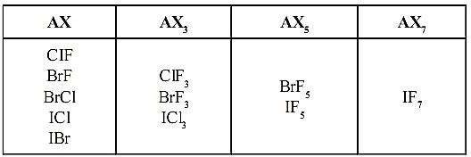
When two different halogens react with each other, interhalogen compounds are formed. They can be assigned general compositions as XX’ , XX’₃ , XX’₅ and XX’₇ where X is halogen of larger size and X’ of smaller size and X’ is more electropositive than X .

Slide 123

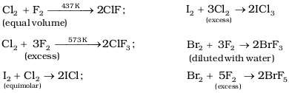
The interhalogen compounds can be prepared by the direct combination or by the action of halogen on lower interhalogen compounds.

Slide 124
These are all covalent molecules and are diamagnetic
in nature.
They are volatile solids or liquids at 298 K except ClF which is a gas.
Their physical properties are intermediate between those of constituent halogens except that their m.p. and b.p. are a little higher than expected.
Their chemical reactions can be compared with the individual halogens.
In general, interhalogen compounds are more
reactive than halogens (except fluorine).
This is because X–X′ bond in interhalogens is weaker than X–X bond in halogens except F–F bond.
All these undergo hydrolysis giving halide ion derived
from the smaller halogen and a hypohalite
XX’ + H₂O → HX’ + HOX

Slide 125

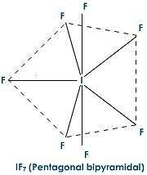
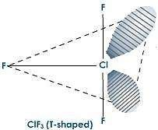
ClF₃
IF₇

Slide 126
These compounds can be used as non aqueous solvents.
Interhalogen compounds are very useful fluorinating agents.
ClF₃ and BrF₃ are used for the production of UF₆ in the enrichment of ²³⁵U.

Slide 127



Due to high electronegativity and small size, fluorine forms only one oxoacid, HOF known as fluoric (I) acid or hypofluorous acid. The other halogens form several oxoacids. Most of them cannot be isolated in pure state. They are stable only in aqueous solutions or in the form of their salts.
Table 7.10: Oxoacids of Halogens
Halic(I) acid (Hypohalous acid) | HOF(Hypofluorous acid) | HOCl(Hypochlorous acid) | HOBr(Hypobromous acid) | HOI(Hypoiodous acid)
Halic (III) acid(Halous acid) | – | HOCIO(chlorous acid) | – | –
Halic (V) acid(Halic acid) | – | HOCIO₂(chloric acid) | HOBrO₂(bromic acid) | HOIO₂(iodic acid)
Halic(VII) acid(Perhalic acid) | – | HOCIO₃(perchloric acid) | HOBrO₃(perbromic acid) | HOIO₃(periodic acid)

Slide 128
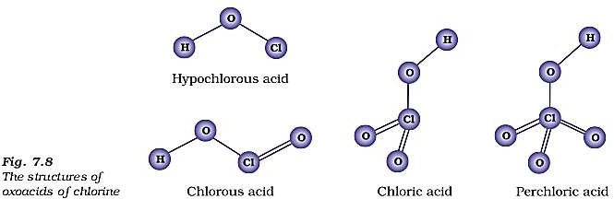

Slide 129
Group 18 elements: Helium (He), neon (Ne), argon (Ar), krypton (Kr), xenon (Xe), and radon (Rn) are Group 18 elements. They are also called noble gases. Their general electronic configuration is ns²np⁶ except helium which has electronic configuration 1s². They are called noble gases because they show very low chemical reactivity.

Slide 130

All the noble gases except radon occur in the atmosphere. Their atmospheric abundance in dry air is ~ 1% by volume of which argon is the major constituent.
Helium and sometimes neon are found in minerals of radioactive origin e.g., pitchblende, monazite, cleveite.
The main commercial source of helium is natural gas.
Xenon and radon are the rarest elements of the group. Radon is obtained as a decay product of
226_{Ra.}
226 _{Ra →}222
Rn +⁴ He
88 86
2

Slide 131
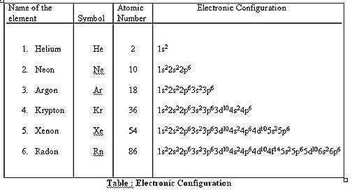
All noble gases have general electronic configuration ns²np⁶ except helium which has 1s² .
Many of the properties of noble gases including their inactive nature are ascribed to their closed shell structures.

Slide 132
Ionisation Enthalpy
Due to stable electronic configuration these gases exhibit very high ionisation enthalpy. However, it decreases down the group with increase in atomic size.
Atomic Radii
Atomic radii increase down the group with increase in atomic number.
Electron Gain Enthalpy
Since noble gases have stable electronic configurations, they have no tendency to accept the electron and therefore, have large positive values of electron gain enthalpy.

Slide 133
All the noble gases are monoatomic.
They are colourless, odourless and tasteless. They are sparingly soluble in water.
They have very low melting and boiling points because the only type of interatomic interaction in these elements is weak dispersion forces.
Helium has the lowest boiling point (4.2 K) of any known substance. It has an unusual property of diffusing through most commonly used laboratory materials such as rubber, glass or plastics.

Slide 134
In general, noble gases are least reactive. Their inertness to chemical reactivity is attributed to the following reasons:
The noble gases except helium (1s² ) have completely filled ns²np⁶ electronic configuration in their valence shell.
They have high ionisation enthalpy and more positive electron gain enthalpy.
The reactivity of noble gases has been investigated occasionally, ever since their discovery, but all attempts to force them to react to form the compounds, were unsuccessful for quite a few years.

Slide 135
Neil Bartlett, then at the University of British Columbia, observed the reaction of a noble gas.
First, he prepared a red compound which is formulated as O₂PtF₆⁻ .
He, then realised that the first ionisation enthalpy of molecular oxygen (1175 kJmol⁻¹ ) was almost identical with that of xenon (1170 kJ mol⁻¹ ).
He made efforts to prepare same type of compound with Xe and was successful in preparing another red colour compound Xe⁺PtF₆⁻ by mixing PtF₆ and xenon.

Slide 136
The compounds of krypton are fewer. Only the difluoride (KrF₂) has been studied in detail.
Compounds of radon have not been isolated but only identified (e.g., RnF₂) by radiotracer technique.
No true compounds of Ar, Ne or He are yet known.

Slide 137
Helium is a non-inflammable and light gas. Hence, it is used in filling balloons for meteorological observations.
It is also used in gas-cooled nuclear reactors. Liquid helium (b.p. 4.2 K) finds use as cryogenic agent for carrying out various experiments at low temperatures.
It is used to produce and sustain powerful superconducting magnets which form an essential part of modern NMR spectrometers and Magnetic
Resonance Imaging (MRI) systems for clinical diagnosis.
It is used as a diluent for oxygen in modern diving apparatus because of its very low solubility in blood.

Slide 138
Neon is used in discharge tubes and fluorescent
bulbs for advertisement display purposes.
Neon bulbs are used in botanical gardens and in green houses.
Argon is used mainly to provide an inert
atmosphere in high temperature metallurgical processes (arc welding of metals or alloys) and for filling electric bulbs.
It is also used in the laboratory for handling substances that are air-sensitive.
There are no significant uses of Xenon and Krypton. They are used in light bulbs designed for special purposes.

